Slide 1
CSI3344 Distributed Systems
Lecture 5:
Processes and Naming Services
  5.1 Processes and Threads
  5.2 Client and Server Processes
  5.3 Names, Addresses, and Identifiers
  5.4 Name Resolution
  Major Points
  Reading Guide
CSI3344
Distributed Systems

Slide 2
Preliminary
To achieve communication in distributed systems, we need
Rules to govern the format, contents, and meanings of massages sent and received – communication protocols;
Systems to support and coordinate the message exchange – middleware;
Actions to carry interactive activities – processes;
A mechanism to distinguish a particular server from any other servers in the systems - naming service.
  -- For a message to be delivered from a client to a specific server among a great number of different servers and resources in distributed systems, the client needs to know the target server’s attributes, such as its name and address, etc.
Distributed Systems
CSI3344

Slide 3

5.1 Processes and Threads (1)
Processes and Threads belong to the regime of (distributed) operating systems.
  System layers – positions of processes & threads
Applications, services
Middleware
OS: kernel,
libraries &
OS1
OS2
servers
Processes, threads,
Processes, threads,
communication, ...
communication, ...
Platform
Computer &
Computer &
network hardware
network hardware
Node 1
Node 2
CSI3344

Slide 4
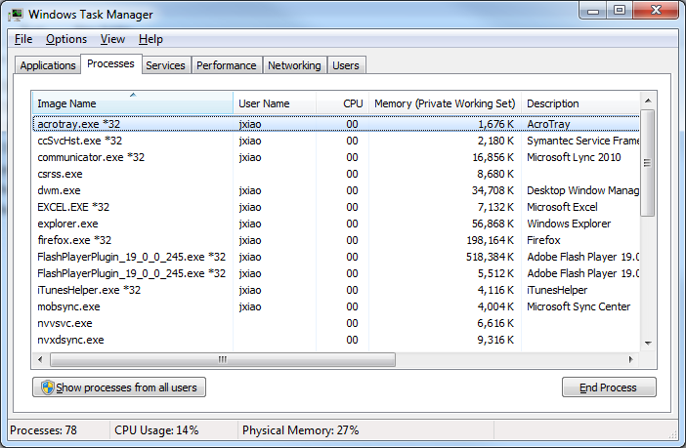
5.1 Processes and Threads (2)
What is a process?
  It is the procedure of a program execution.
  An operating system creates a number of virtual processors, each is for running a specific program.
  Operating system has a process table to keep track of these virtual processors.
  A process is often
  defined as a program
  in execution, i.e., a
  program that is currently
  being executed on one
  of the operating system’s
  virtual processors.
CSI3344
Distributed Systems

Slide 5
5.1 Processes and Threads (3)
When a process is created, a memory address space is allocated to it.
2^{N}
Virtual processors
Auxiliary
regions
Process
Process
Stack
A
B
Kernel
Heap
Virtual processors
Text
0
Distributed Systems
CSI3344
Notes:
A process is a program in execution, whereas a thread is a path of execution within a process. Processes are generally used to execute large, ‘heavyweight’ jobs such as running different applications, while threads are used to carry out much smaller or ‘lightweight’ jobs such as auto saving a document in a program, downloading files, etc. Whenever we double-click an executable file such as Paint, for instance, the CPU starts a process and the process starts its primary thread.

Slide 6
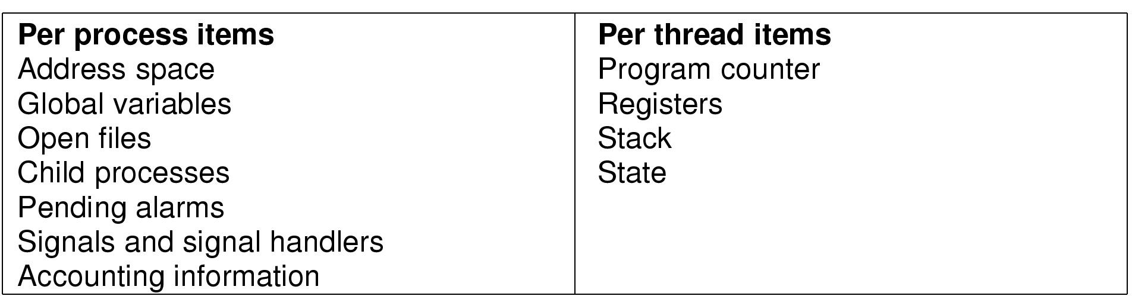
5.1 Processes and Threads (4)
Items contained in a process
Memory items
CPU items
CSI3344
Distributed Systems

Slide 7
5.1 Processes and Threads (5)
What is a thread?
  A thread is very similar to a process in the sense that it can also be seen as the execution of a (part of a) program on a virtual processor. It generally maintains only the minimum information (CPU context) to allow a CPU to be shared by several threads.
CSI3344
Distributed Systems

Slide 8

5.1 Processes and Threads (6)
The thread model
2
3
(a) Three processes each with one thread
(b) One process with three threads
CSI3344
Distributed Systems
Notes:
A thread within a process
Each process runs in a separate address space in the CPU. But threads, on the other hand, may share address space with other threads within the same process. This sharing of space facilitates communication between them. Therefore, Switching between threads is much simpler and faster than switching between processes.
Threads also have a great degree of control over other threads of the same process. Processes only have control over child processes.
Also, any changes made to the main thread may affect the behavior of other threads within the same process. However, changes made to the parent processes do not affect the child processes.
Considering the similarities, a thread can do anything that a process can do. They are both able to reproduce (Processes create child processes and threads create more threads), and they both have ID, base priority, execution time and exit status as attributes.

Slide 9

5.1 Processes and Threads (7)
Example: Word processor with three threads
Threads and processes together offer concurrent transparency.
CSI3344

Slide 10
5.1 Processes and Threads (8)
Threads in distributed systems
Multithreaded Clients
  A client machine with multithreads can use several threads
    - one after another, to separately fetch data of a particular document from the same server (e.g., a Web browser), or
    - at the same time to fetch data of a particular document, in parallel, from its replicas in several other servers (e.g., a replicated database system).
Multithreaded Servers
  Multithreaded server can provide processing for parallel requests, with partial system call blocking.
CSI3344

Slide 11
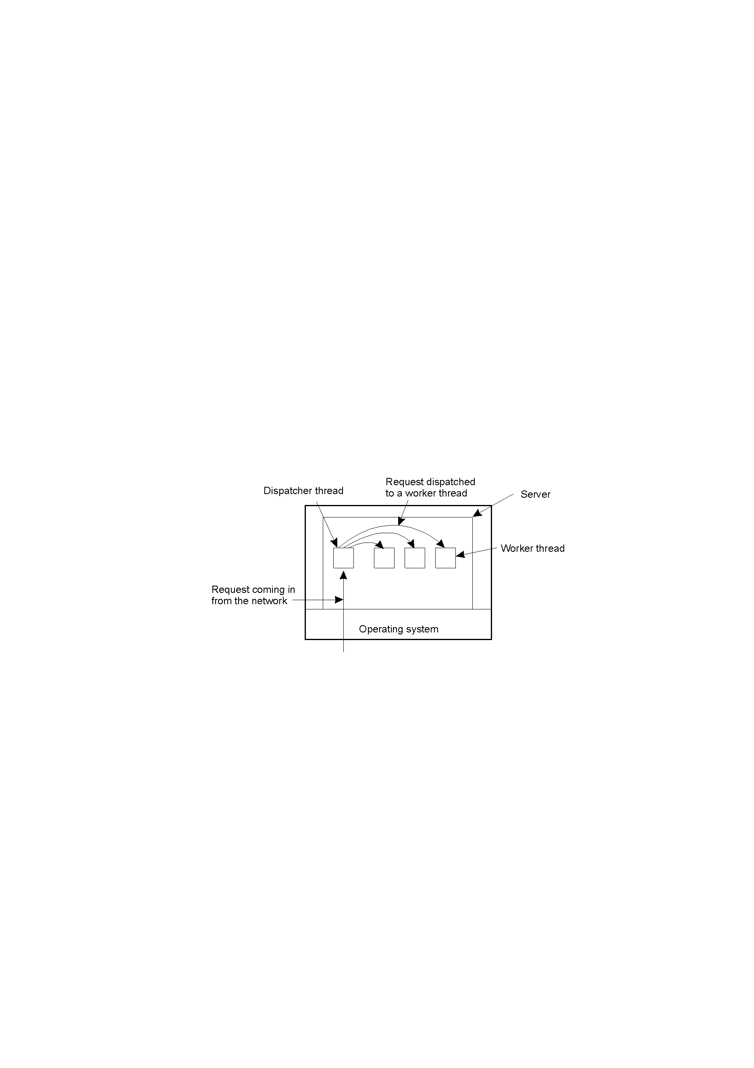
5.1 Processes and Threads (9)
Example: a multithreaded file server
CSI3344

Slide 12
5.2 Client and Server Processes (1)
Client processes generally implement user interfaces.
  All user actions with PCs/workstations are performed with user interfaces on the client side
      - e.g., drag-and-drop, in-place editing
  All user requests to remote servers are sent through actions on user interfaces on the client side
  - e.g., Web search, sending and receiving emails
  Client software provides support for achieving distribution transparency by hiding details concerning the communication with servers.
CSI3344

Slide 13
5.2 Client and Server Processes (2)
Server processes generally implement a specific service on behalf of a collection of clients.
Basic functions of each server are organized as:
  Waiting for an incoming request from a client;
  Ensuring that this request is processed properly; and
  After finishing the last service, waiting for the next incoming request.
CSI3344
Distributed Systems

Slide 14
5.2 Client and Server Processes (3)
Server classification
  Iterative server
    The server itself handles the request and, if necessary, responds to the requesting client.
  Concurrent server
    The server itself does not handle the request, but passes it to a separate process/thread, and then immediately waits for the next incoming request.
      The process/thread that processes the request is then responsible for returning a response to the requesting client (multithreaded servers).
  Stateless server
    The server does not keep information on the state of its client ( eg, a Web server).
  Stateful server
    The server keeps information on the state of its clients ( e.g., server for some online surveys).
CSI3344

Slide 15
5.2 Client and Server Processes (4)
Two issues on server design
  A Mechanism to interrupt a server after a request has been sent
  Addressing services – where a request to go (port/endpoint allocation)?
  - e.g., servers for Internet FTP – TCP port 21;
  HTTP servers for World Wide Web – TCP port 80.
CSI3344
Distributed Systems

Slide 16
5.3 Names, Addresses, and Identifiers (1)
What is a name (in a distributed system)?
A string of bits - mostly for naming an internal entity, or
A string of characters - for naming a visible entity to users
URL
http://www.cdk3.net:8888/WebExamples/earth.html
Name
DNS lookup
Resource ID (IP number, port number, pathname)
55.55.55.55
8888
WebExamples/earth.html
file
Web server
Name
CSI3344
Notes:
DNS = distributed/dynamic naming service

Slide 17
5.3 Names, Addresses, and Identifiers (2)
What is an entity (in a distributed system)?
  can be anything associated with the system
    - e.g., client machines, servers, printers, files, disks, users, Web pages, communication ports, etc.
URL
http://www.cdk3.net:8888/WebExamples/earth.html
DNS lookup
Resource ID (IP number, port number, pathname)
55.55.55.55
8888
WebExamples/earth.html
file
Web server
Entity
CSI3344
Notes:
An identity: anything that is capable of being uniquely identified.

Slide 18
5.3 Names, Addresses, and Identifiers (3)
What is an address?
  To operate on an entity, we need an access point (a special kind of entity) to access it. The name of an access point of an entity is called an address of that entity.
URL
http://www.cdk3.net:8888/WebExamples/earth.html
DNS lookup
Resource ID (IP number, port number, pathname)
55.55.55.55
8888
WebExamples/earth.html
file
Web server
Address
CSI3344

Slide 19
5.3 Names, Addresses, and Identifiers (4)
Relations between entity, name and address
  An entity may be referred by more than one name (e.g., Web page favorites).
  A name may be used by more than one entity (e.g., same name used by a printer and a file).
  An address is also a name (of an access point of an entity).
  An entity may be referred by more than one access point or address (e.g., access a document by either FTP or HTTP).
  An entity may change its address and/or name in the course of time (e.g., a file server is moved or renamed).
CSI3344
Distributed Systems

Slide 20
5.3 Names, Addresses, and Identifiers (5)
What is an identifier?
  A name that has the following three properties:
    An identifier refers to at most one entity;
    Each entity is referred to by at most one identifier;
    An identifier always refers to the same entity (never reused).
    Example: network card, FTP port, HTTP port
Addresses and identifiers are two important names, and often expressed in the form of bit string.
CSI3344

Slide 21
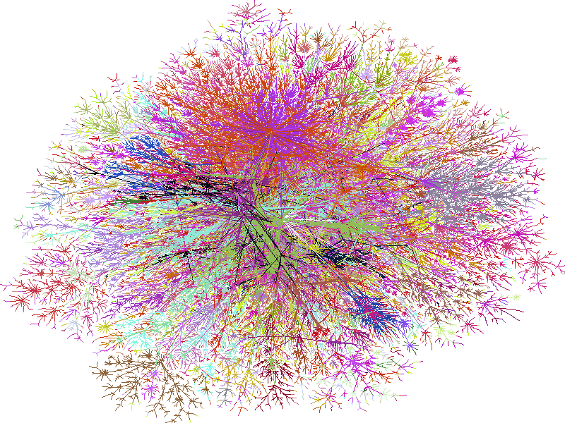
5.3 Names, Addresses, and Identifiers (6)
Why Dynamic Naming Service (DNS)?
- Network of Internet (part, as in 1996)
CSI3344

Slide 22
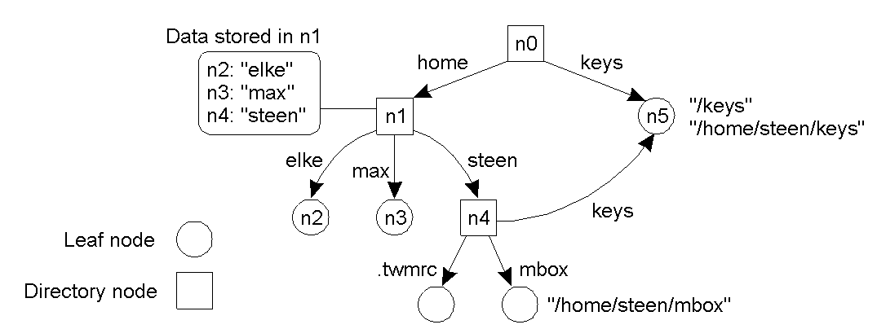

5.3 Names, Addresses, and Identifiers (7)
Name Space
Names in a distributed system are organized as a name space that can be illustrated as a labeled, directed graph with two types of nodes (i.e., leaf and directory nodes).
Example: A general naming graph with a single root node
CSI3344

Slide 23
5.3 Names, Addresses, and Identifiers (8)
A leaf node:
  Is a named entity;
  Has no outgoing edges;
  Stores information on the entity it represents.
Examples: A printer, an independent file in a file server.
CSI3344

Slide 24
5.3 Names, Addresses, and Identifiers (9)
A directory node:
  Is a named entity with an identifier;
  Has a number of named outgoing edges;
  Stores information about the outgoing edges.
Edge
Identifier
CSI3344
Distributed Systems

Slide 25
5.3 Names, Addresses, and Identifiers (10)
A directory table within a directory node stores information about the outgoing edges, and each outgoing edge is represented as a pair of (node identifier, edge label).
Directory
table
Edge label
Node Id
CSI3344

Slide 26
5.3 Names, Addresses, and Identifiers (11)
A directory node with only outgoing edges, but no incoming edges, is called the root node of the naming graph (or name space).
  Normally, a naming graph has only one root.
Root node
CSI3344

Slide 27
5.3 Names, Addresses, and Identifiers (12)
A sequence of edge labels (thus nodes) that can lead to a referred node in a naming graph is called a path name (to that node).
If a path name starts with the root, it is called an absolute path name; otherwise it is called a relative path name.
There are two popular forms to express a path name:
n: <label₁, label₂ ,… label_{k} > (mainly for relative path name), or
/label₁/label₂ /… /label_{k} (mainly for absolute path name)
n0: <keys>
n0: <home,steen,keys>
n1: <steen,mbox>
n0: <home,steen,mbox>
/home/steen/mbox
CSI3344

Slide 28
5.4 Name Resolution (1)
What is name resolution?
  Given a path name, it should be able to look up any information stored in the node referred to by that name. This process of looking up a name is called name resolution.
How is name resolution carried out?
  Given a path name, resolution of this name starts from an initial node, and then tracks down to next node by consulting with the directory table stored in each node.
CSI3344

Slide 29
5.4 Name Resolution (2)
Example: given a path name
n0: <home, steen, mbox> or /home/steen/mbox
n0: <home,steen,mbox>
CSI3344

Slide 30
5.4 Name Resolution (3)
Aliases
  An alias is another name for the same entity.
There are two approaches to implement an alias:
  1. Allow multiple absolute path names to refer to the same node. (e.g., n5);
CSI3344

Slide 31
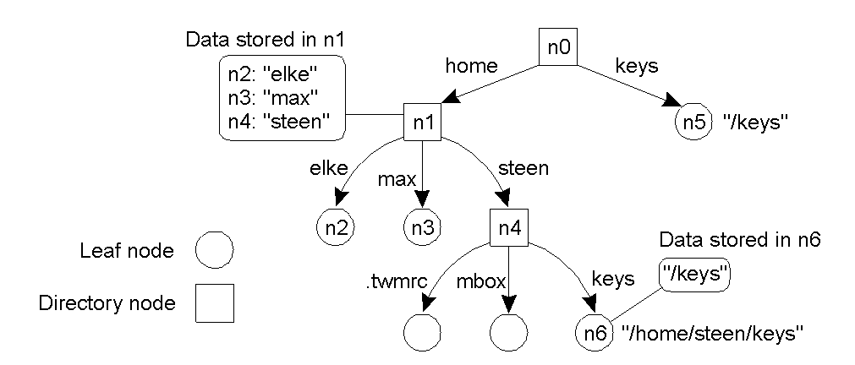
5.4 Name Resolution (4)
Aliases (cont…)
  2. Create a leaf node in which only its absolute path name is stored, instead of its address or state (e.g., n6).
    Something like a shortcut of the directory folder
CSI3344

Slide 32
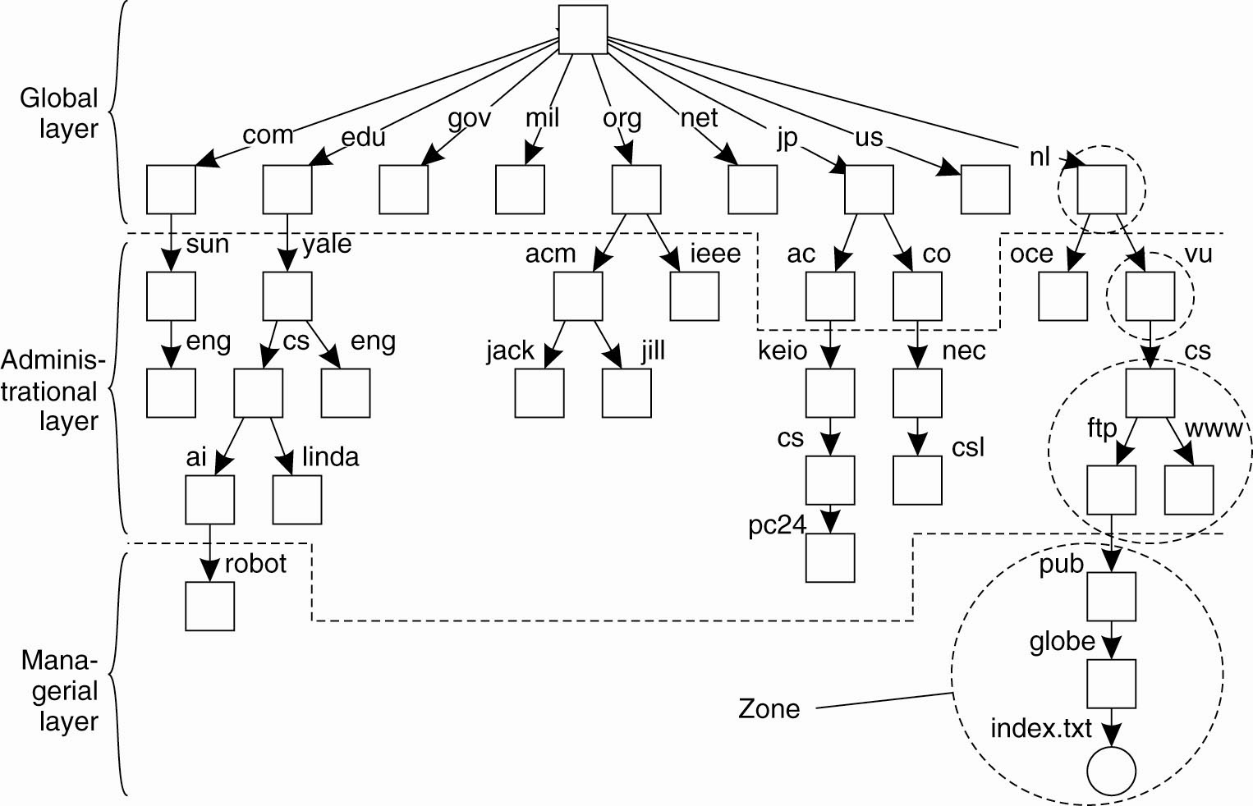
Name Space Distribution
An example partitioning of the DNS name space, including Internet-accessible files, into three layers.
CSI3344

Slide 33
Major Points
Difference between processes and threads
What do the client and server processes generally implement, respectively?
Server classification
Relations between entity, name and address
What are absolute and relative path names?
Given a naming graph, to be able to express a node name path by two different ways.
Two approaches to implement an alias
CSI3344

Slide 34
Reading Guide
DSPP
Chapter 3: Sections 3.1, 3.2, 3.3
Chapter 5: Sections 5.1, 5.2, 5.3, 5.4
CSI3344

